Slide 1
Comprehensive
Sentiment Analysis
An End-to-End Comparative Study: From Traditional ML to Transformers
1 / 39

Slide 2
Agenda & Logical Flow
Phase 1: Foundation - Datasets & Text Normalization
Phase 2: Traditional ML (Baseline) - TF-IDF, LR, SVM, and Decision Trees
Phase 3: Word Embeddings - The bridging representation for Deep Learning
Phase 4: Deep Learning - CNN, LSTM, and the Freezing Dilemma
Phase 5: The Transformer - DistilBERT Evaluation
Phase 6: Engineering Conclusions - Trade-offs and Architecture
2 / 39

Slide 3
Phase 1: Text Classification Setup
Datasets, Normalization, and Architecture constraints
3 / 39

Slide 4



Dataset 1: IMDB Movie Reviews
Characteristics
Source: via HuggingFace
Structure: Long, highly detailed paragraphs.
Content: Often contains extensive neutral plot summaries alongside emotional opinions.
Challenge: Requires the model to maintain long-term memory and filter out non-sentiment noise over hundreds of words.
4 / 39

Slide 5

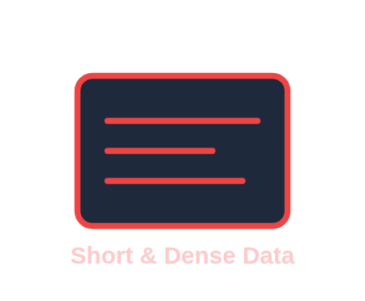

Dataset 2: Rotten Tomatoes
Characteristics
Source:
Structure: Extremely short, dense, and heavily edited text snippets.
Content: Direct, punchy opinions without fluff.
Challenge: Because of the brevity, missing or misinterpreting a single critical word can flip the predicted sentiment entirely.
5 / 39

Slide 6

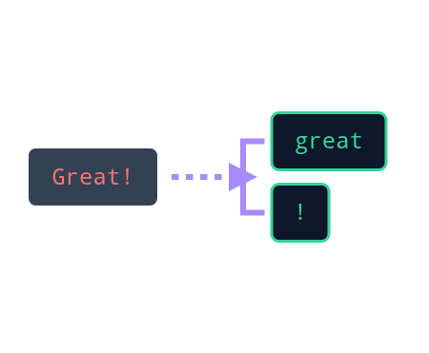
Text Normalization Pipeline
Raw web data is messy. We built to handle:
HTML Stripping: Removing artifacts like common in the IMDB dataset.
Lowercasing: Ensuring "The" and "the" map to the same mathematical representation.
Punctuation Separation: Detaching symbols so "bad!" doesn't become a unique token distinct from "bad".
6 / 39

Slide 7
Hyperparameter: Sequence Length
Standardizing Input Tensors
200
Neural networks demand fixed-size inputs. We set the limit to 200 words per review.
Padding: Reviews shorter than 200 words are padded with a zero-index token.
MAX_SEQ_LENGTH
Truncation: Reviews longer than 200 words are chopped. This means we might lose concluding thoughts in IMDB, presenting a known limitation.
7 / 39

Slide 8
Phase 2: Traditional ML
Establishing Our Baseline Metrics
8 / 39

Slide 9
TF-IDF Vectorization
Bridging Text and Classical Math
5000
Traditional models cannot ingest raw sequence matrices. We collapsed the text into sparse vectors using Term Frequency-Inverse Document Frequency.
We capped the extraction at 5000 features. This prevents memory overflow while retaining the most statistically powerful sentiment markers (e.g., "terrible", "masterpiece").
MAX_FEATURES
9 / 39

Slide 10









Traditional Models Evaluated
Logistic Regression
Linear SVM
Decision Tree
Fast, linear model. Exceptional at finding direct correlations with specific TF-IDF keywords.
Finds the optimal mathematical hyper-plane to separate positive and negative vectors.
Capped depth strictly at 20 to prevent massive overfitting on the training set.
10 / 39

Slide 11
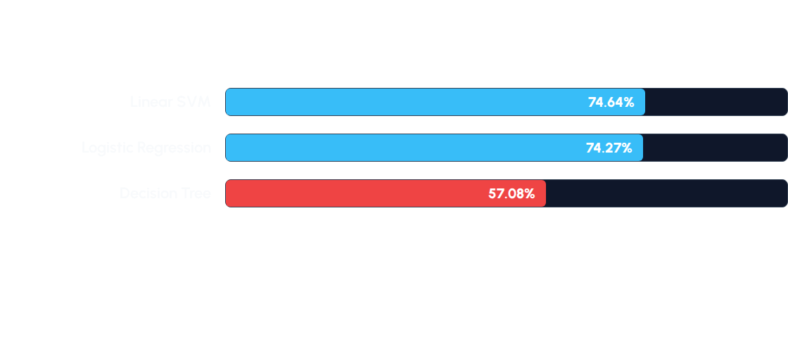

Results: Traditional ML (Rotten Tomatoes)
Performance on short, dense, context-heavy sentences:
Observation: Short sentences lack enough repeated keyword frequency for TF-IDF to shine. The models struggle without deep context.
11 / 39

Slide 12
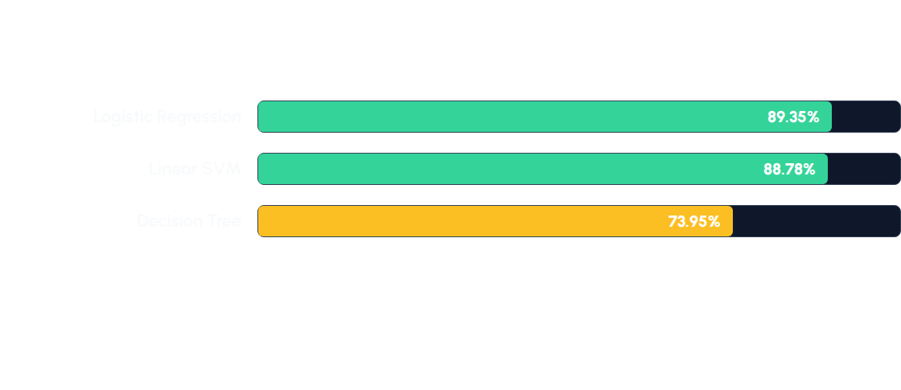
Results: Traditional ML (IMDB)
Performance on long, keyword-rich reviews:
Observation: With enough text length, simple linear correlation works incredibly well! The presence of specific words is a strong enough signal.
12 / 39

Slide 13
The Power of Simplicity
Speed vs Accuracy
0.53s
Logistic Regression achieved 89.35% accuracy on IMDB in roughly half a second of total training time.
This establishes a fiercely competitive baseline. Any Deep Learning model we implement next must justify its massive compute cost by significantly beating this score.
LR Train Time
13 / 39

Slide 14
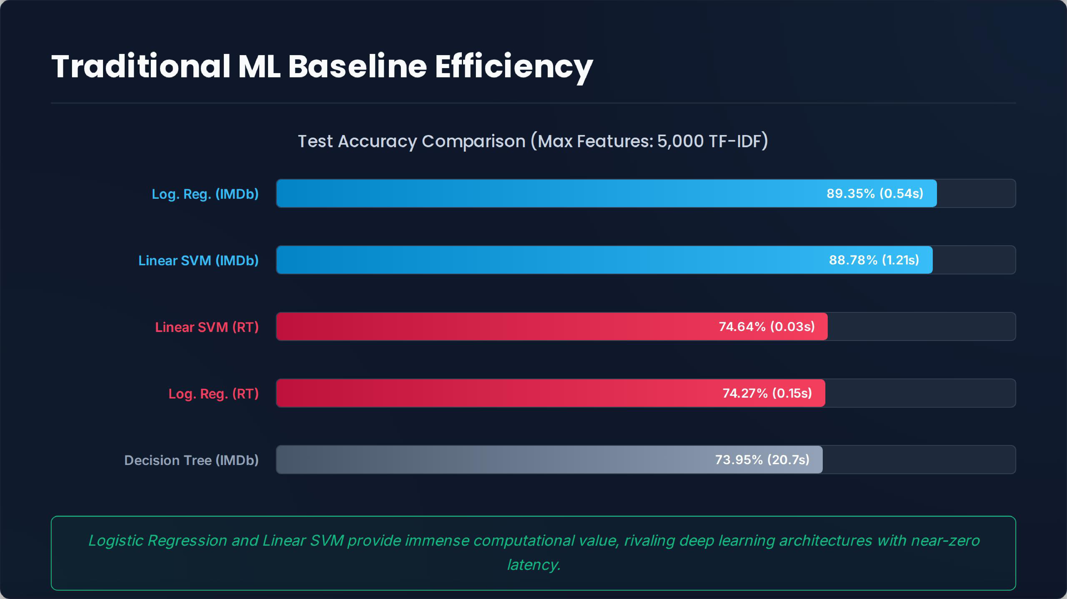

Slide 15
Phase 3: Word Embeddings
The required representation for Deep Learning
14 / 39

Slide 16






The Three Embedding Strategies
1. Random Init
2. GloVe (Pretrained)
3. Custom Word2Vec
Starting with completely random weights. The neural network must learn English grammar and sentiment entirely from scratch based only on our dataset.
Pretrained on 6 Billion web tokens. Provides excellent general English semantics instantly, projecting words into a known 300D spatial relation.
Trained exclusively on our specific movie review corpus to capture domain-specific terminology and context.
15 / 39

Slide 17




Custom Word2Vec Parameters
Parameter | Value | Reasoning
VECTOR_SIZE | 512 | High dimensionality captures complex nuances and relationships.
WINDOW | 5 | Context scope: looks 5 words forward and backward.
SG | 1 | Utilizes Skip-Gram architecture rather than CBOW.
EPOCHS | 7 | Ensured deep convergence over our specific corpus.
16 / 39

Slide 18


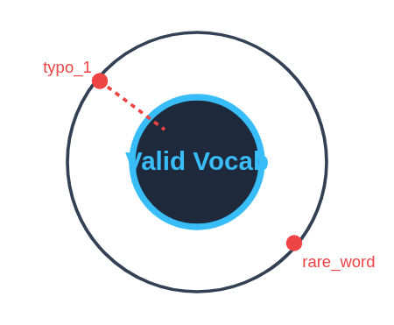
Handling Out of Vocabulary (OOV)
Min_Count & UNK Tokens
Words appearing 1 or 2 times are discarded to remove typos and extreme outliers.
During testing, any unseen word is mapped to index 1: .
Benefit: Drastically reduces noise and prevents overfitting on rare test words.
17 / 39

Slide 19
Phase 4: Deep Learning
Convolutional and Recurrent Neural Networks
18 / 39

Slide 20



Deep Learning Hyperparameters
Parameter | Value | Reasoning
BATCH_SIZE | 32 | Standard balance of GPU memory usage and gradient stability.
LEARNING_RATE | 0.001 | Default optimum for the Adam optimizer.
DROPOUT | 0.5 | Heavy regularization applied to combat rapid overfitting.
19 / 39

Slide 21
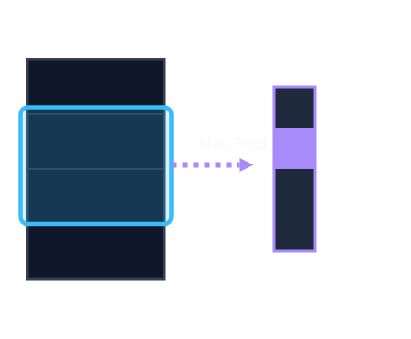


TextCNN Architecture
1D Convolutions over Text
Instead of image pixels, our CNN slides filters across word embeddings to find n-grams.
Filter Sizes: (Captures 3-word, 4-word, and 5-word phrases).
Features: filters per size (300 total features extracted).
Pooling: Max-Over-Time Pooling extracts the single strongest signal from each filter across the entire sentence length.
20 / 39

Slide 22
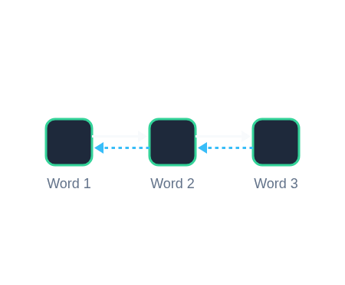


TextLSTM Architecture
Sequential Memory
Processes text word-by-word sequentially, maintaining a "hidden state" of past context.
Hidden Dim: (The size of the memory vector).
Depth: stacked layers for deeper abstraction.
Bidirectional: Reads left-to-right AND right-to-left, concatenating results (512 total output dim).
21 / 39

Slide 23

The Freezing Dilemma
Freeze = True
Freeze = False
Embedding layer weights are locked. The network must learn to classify using the existing spatial relationships of GloVe or Word2Vec.
Gradients propagate all the way back to the embeddings, shifting the word vectors around during training (Fine-tuning).
Pros: Faster training, heavily resists overfitting.
Cons: Cannot adapt general word meanings to the specific dataset.
Pros: Highly tailored representations.
Cons: Easy to destroy pretrained knowledge and massively overfit.
22 / 39

Slide 24




24 Combinations Tested
We automated a pipeline to test all possible architecture variations:
2
3
2
12
X
X
=
Models
(CNN, LSTM)
Embeddings
(Rand, GloVe, W2V)
States
(Frozen, Unfrozen)
Runs per Dataset
23 / 39

Slide 25
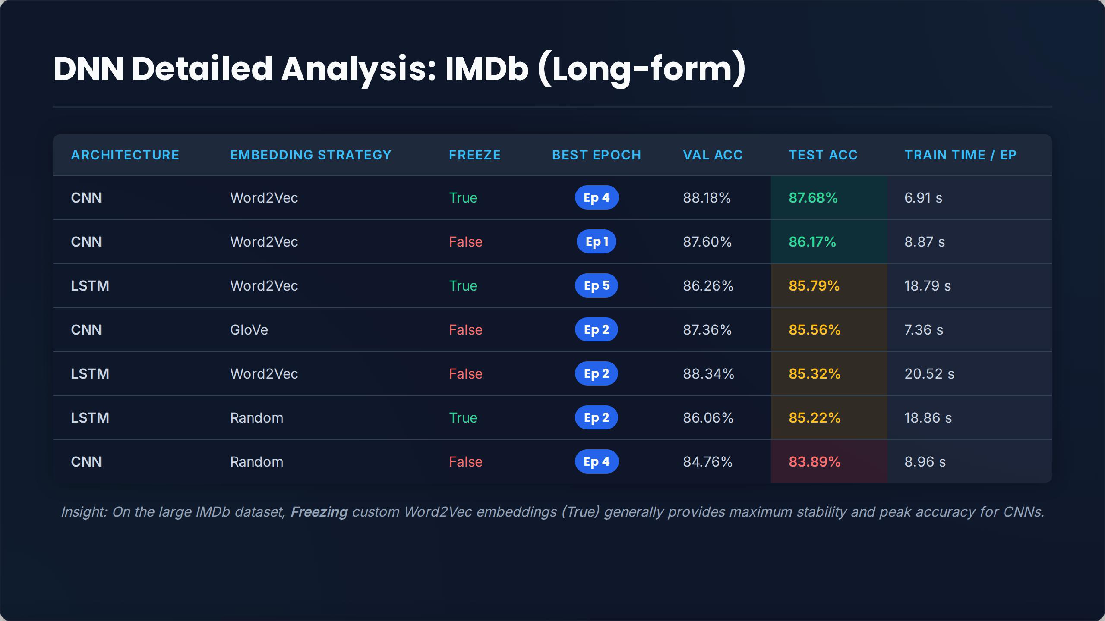

Slide 26
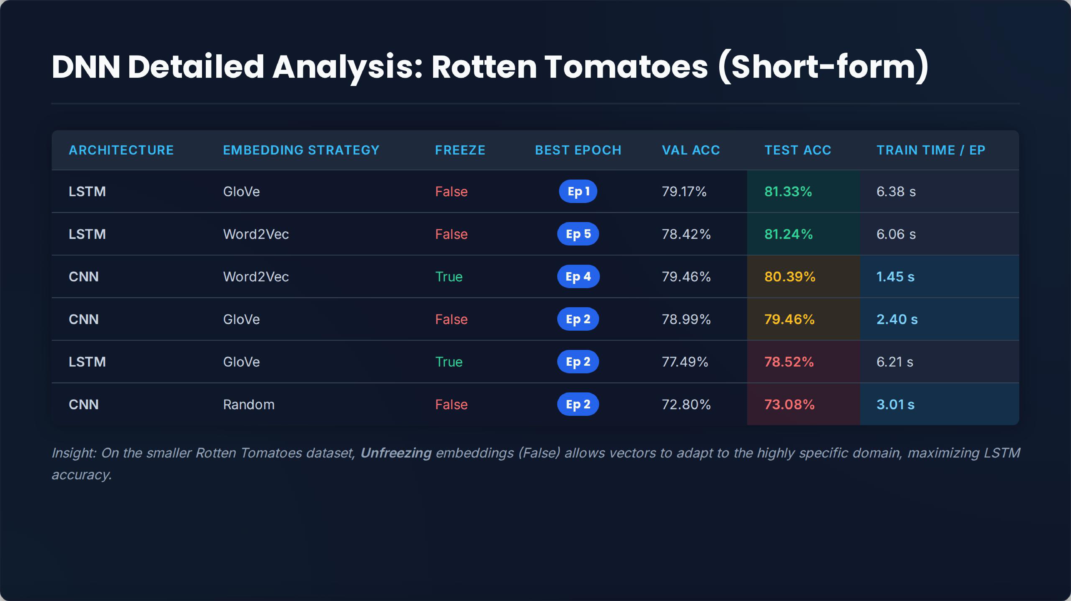

Slide 27
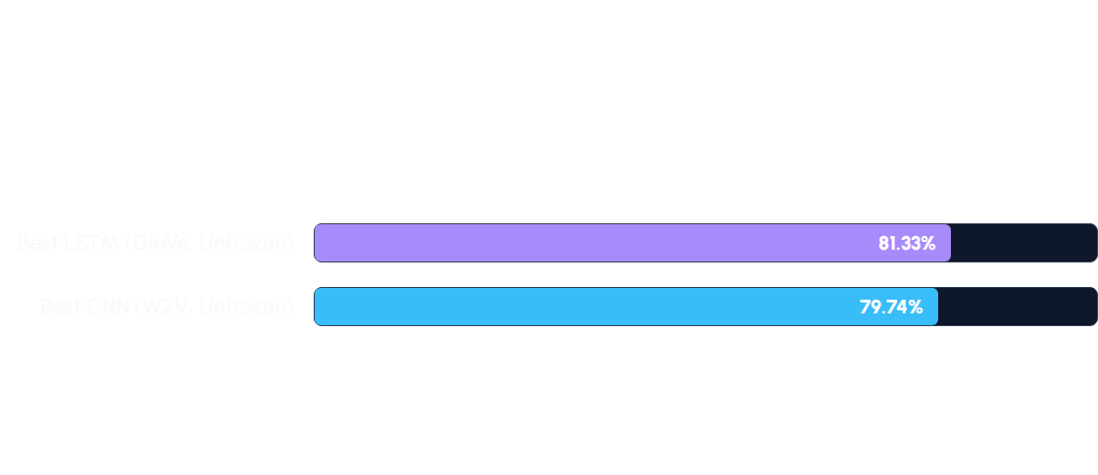
Rotten Tomatoes: DL Overview
Highest achieved Test Accuracy across all combinations:
24 / 39

Slide 28
Rotten Tomatoes: Detailed Matrix
Model | Embedding | Freeze | Test Accuracy
LSTM | GloVe | False | 81.33%
LSTM | Word2Vec | False | 79.55%
CNN | Word2Vec | False | 79.74%
CNN | Random | True | 68.57%
25 / 39

Slide 29
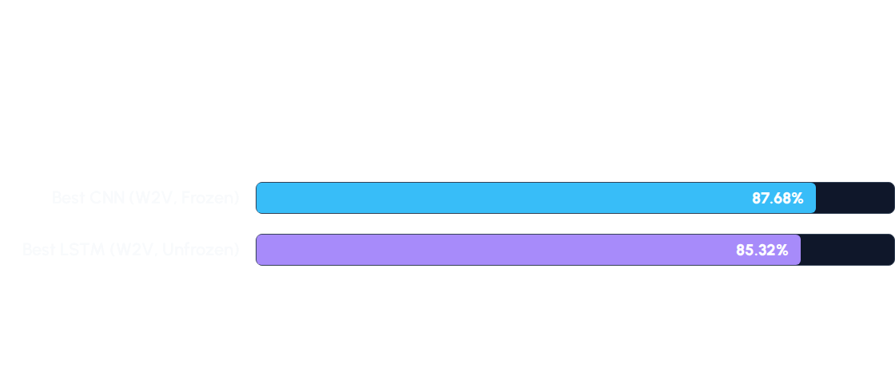
IMDB: DL Overview
Highest achieved Test Accuracy across all combinations:
26 / 39

Slide 30
IMDB: Detailed Matrix
Model | Embedding | Freeze | Test Accuracy
CNN | Word2Vec | True | 87.68%
CNN | GloVe | False | 85.56%
LSTM | Word2Vec | False | 85.32%
LSTM | GloVe | True | 83.27%
27 / 39

Slide 31

Insight 1: The Text Length Paradox
Short Text (Rotten Tomatoes)
Long Text (IMDB)
Winner: LSTM
Winner: CNN
When sentences are extremely short, the exact sequence and context of every single word matters. The LSTM successfully tracked these dense relationships.
Over 200 words, LSTM gradients struggle and it loses context. The CNN, acting as an n-gram scanner, easily "fished" out key sentiment phrases regardless of where they appeared.
28 / 39

Slide 32
Tracking Progress Across Epochs
To understand model behavior, we tracked metrics across 5 epochs. This revealed critical differences between frozen and unfrozen layers .
Epoch | Train Loss | Train Acc | Validation Acc
1 | 0.6802 | 68.0% | 62.6%
2 | 0.3111 | 87.5% | 88.3%
3 | 0.1658 | 94.1% | 87.6%
... | ... | ... | ...
29 / 39

Slide 33


Insight 2: The Memorization Trap
When unfreezing embeddings on IMDB (CNN + Word2Vec), the model stopped learning language and started memorizing specific reviews, causing severe overfitting.
Epoch 2
Epoch 5 (Complete Overfit)
Train Accuracy: 87.5%
Train Accuracy: 98.7%
Validation Acc: 88.3%
Validation Acc: 86.5% (Stagnated)
* Data extracted directly from `imdb | CNN | Word2Vec | FreezeFalse` run logs.
30 / 39

Slide 34
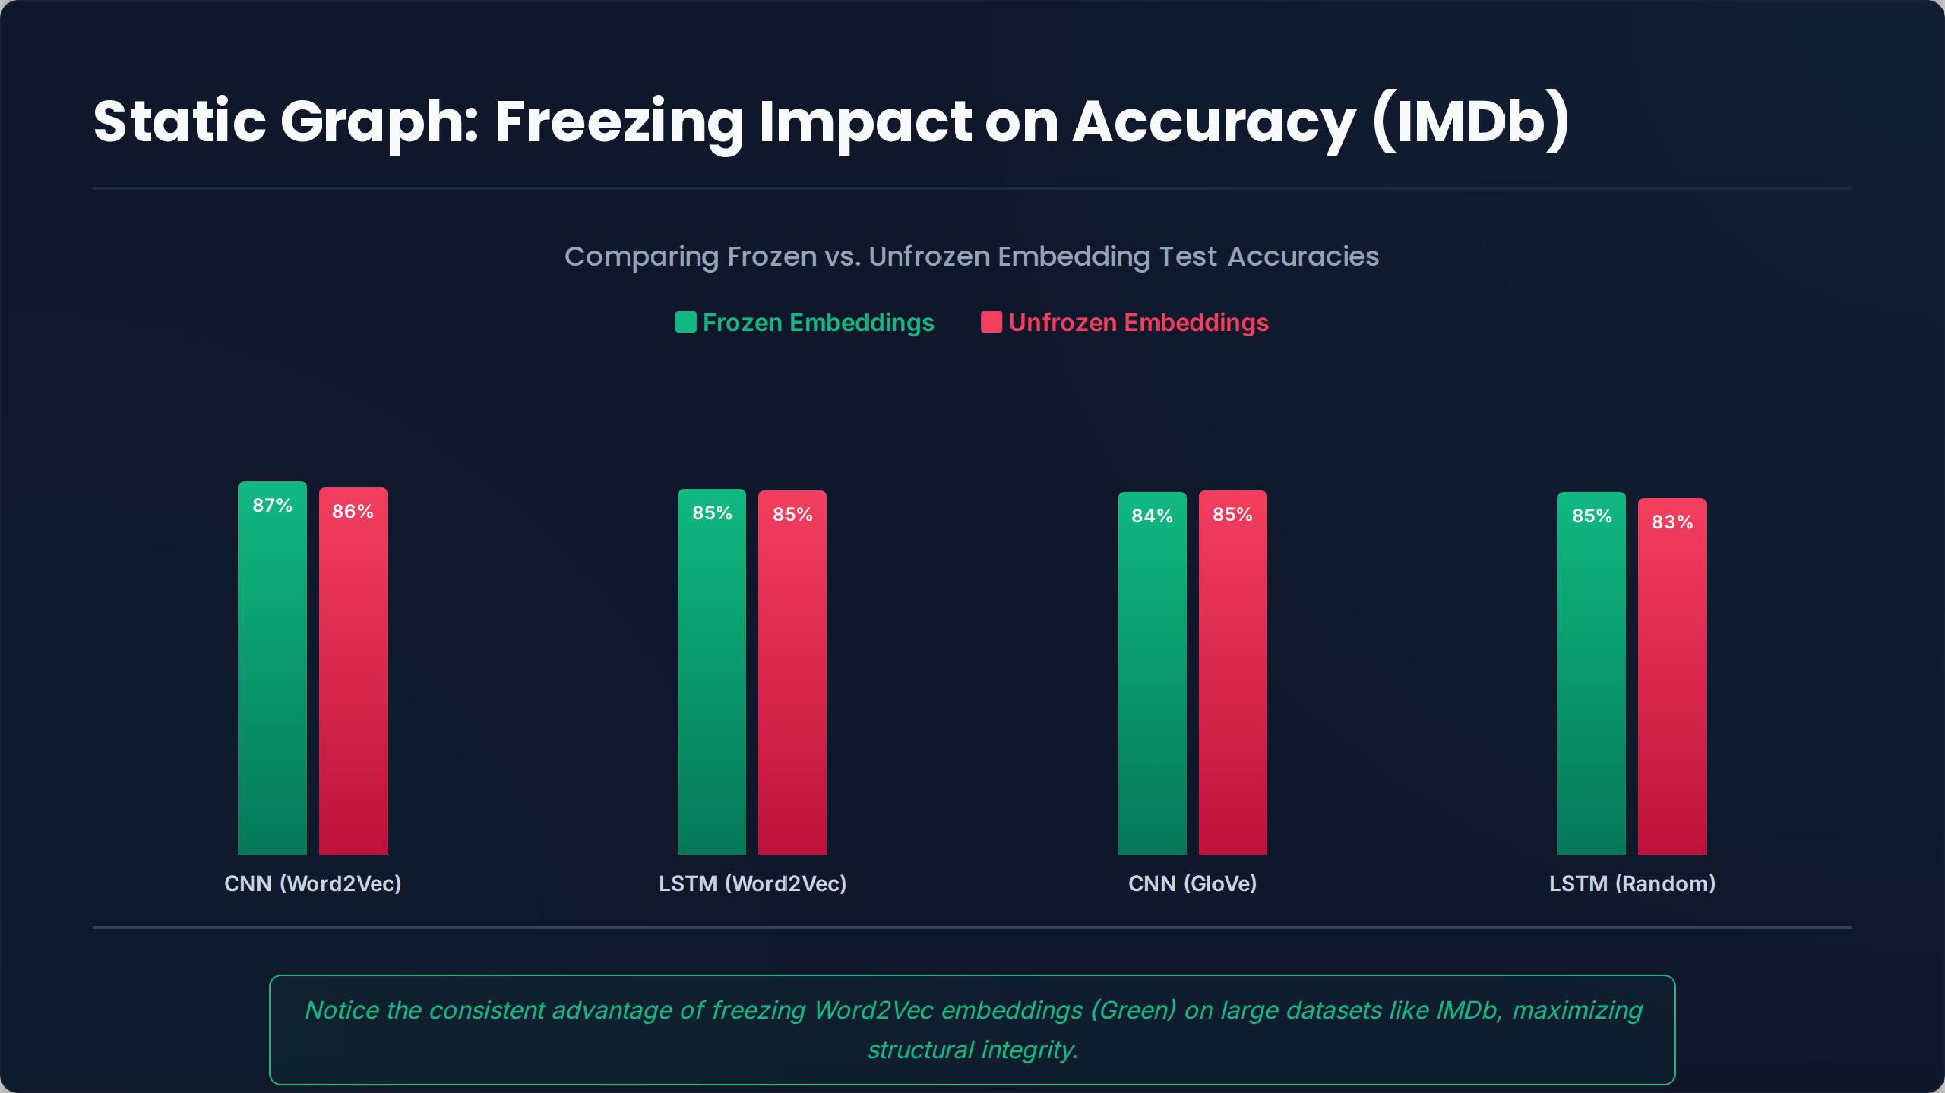

Slide 35
Phase 5: The Transformer
Breaking the Ceiling with DistilBERT
31 / 39

Slide 36

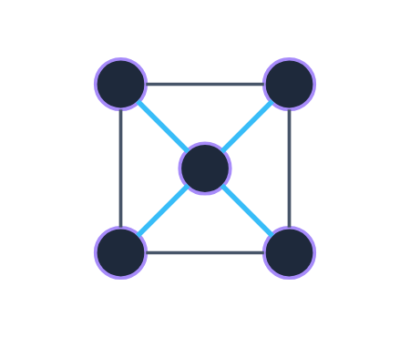
Enter DistilBERT
The Self-Attention Paradigm
Instead of reading left-to-right (LSTM) or scanning small windows (CNN), Transformers use Self-Attention.
Every word looks at every other word in the sentence simultaneously.
Builds rich, bidirectional contextual matrices instantly.
We used — a lighter version retaining 97% of BERT's language capacity.
32 / 39

Slide 37
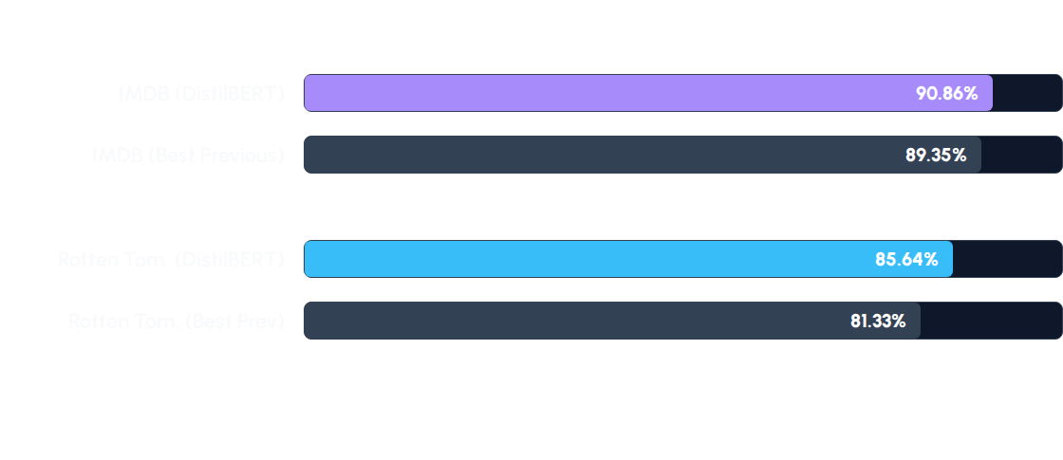
Transformer Results (Just 3 Epochs)
DistilBERT achieves the highest accuracy among all tested models.
33 / 39

Slide 38
The Cost of Attention
Massive Compute Requirements
194s
The accuracy gain comes at a severe computational cost. Training DistilBERT on IMDB took roughly 194 seconds per epoch.
Compare this to the CNN which took ~7 seconds, or Logistic Regression which took 0.5 seconds in total.
Train Time per Epoch
34 / 39

Slide 39

Insight 3: The Ultimate Trade-off (ROI)
Model | Accuracy (IMDB) | Time (Epoch/Total) | Complexity
Logistic Regression | 89.35% | 0.53 seconds | Low (TF-IDF)
CNN + Word2Vec | 87.68% | ~6.9 seconds | Medium
DistilBERT | 90.86% | 194 seconds | Extreme
The Engineering Dilemma: Is a ~1.5% accuracy gain of DistilBERT over simple Logistic Regression worth a massive increase in compute time and cost? For massive scale deployments, Traditional ML remains incredibly potent.
35 / 39

Slide 40
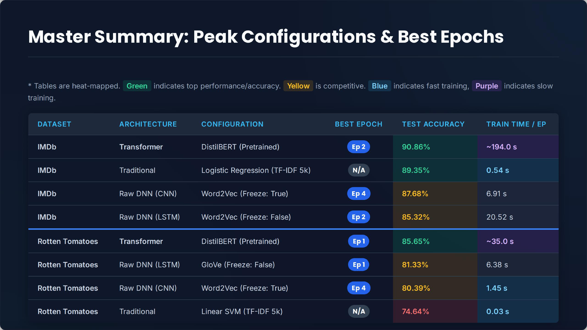

Slide 41
Phase 6: Project Architecture
Behind the scenes of the codebase
36 / 39

Slide 42





Code Architecture & Modularity
Separation of Concerns
Unified Pipeline
acts as the single source of truth for all hyperparameters.
Data loading () and text normalization () are strictly isolated from the math networks.
Using and , we established a standardized training loop. This allowed us to execute and log all 26 deep learning combinations automatically.
37 / 39

Slide 43
Conclusions
Baseline vs. Deep Learning: Traditional ML (LR + TF-IDF) is remarkably fast and powerful, providing a very tough baseline to beat on long texts.
Context Matters: LSTM shines on short, dense text; CNN excels at fast feature extraction over long documents.
Regularization: Unfreezing embeddings without massive datasets leads directly to memorization instead of learning.
Transformers: Easily top the accuracy charts, but demand careful consideration of computational ROI.
38 / 39

Slide 44
Questions?
Thank you for your attention.
End of Presentation
39 / 39

